Slide 1
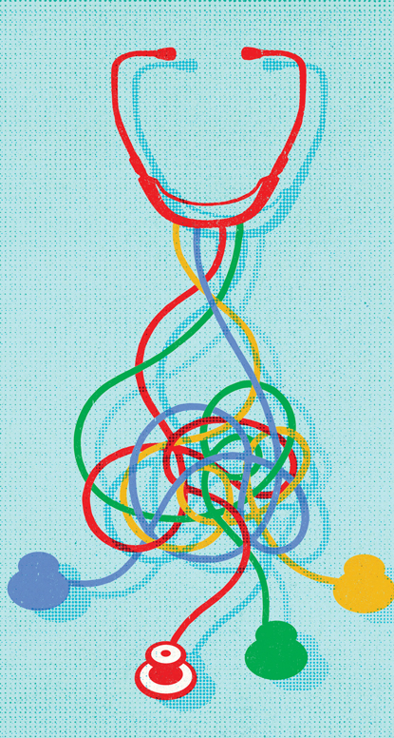
Ethics Consults on What Basis:
Is Principlism All You Need?
The Case For Principlism
Daniel Miller

Slide 2
Ethical Theory
Two Central Criteria for an Ethical Theory:
(i) The theory explains what makes actions right or wrong, and (in virtue of this)
(ii) the theory offers guidance about what we ought to do in a particular case.
Principlism satisfies both of these criteria.
    (Note: I use “ethical” and “moral” interchangeably)

Slide 3
A Single Principle?
Utilitarianism: Perform the action that results in the most net good.
Kantianism: Act in accordance with the categorical imperative (e.g., treat autonomous persons as ends and never as mere means).
We cannot capture rightness and wrongness in a single principle. To see why, we can ask:
What Matters?

Slide 4
Benefit & Harm
We can begin to see what matters for medical ethics by asking:
Q: What is the purpose of health care?
Benefit people in terms of their overall well-being.
Prevent harm through medical interventions (and by refraining from certain interventions).
More specifically, the balance of benefit over harm.
E.g., Amputation, chemotherapy

Slide 5
Personal Rights
But if benefit and harm were all that mattered, then there might be nothing wrong with:
Harvesting organs of one patient to save five others.
Euthanizing elderly patients to reallocate resources.
Withholding the truth from a patient.
Each of these actions are morally wrong, even though they might produce the greatest overall net benefit.
The actions are wrong because they fail to respect the rights—the autonomy—of certain individuals.

Slide 6
Justice
In addition to the amount of benefit/harm that some action produces, it also matters that benefits or harms are fairly distributed.
This is a matter of Justice.
E.g., Organ transplant
E.g., Conscientious objection

Slide 7
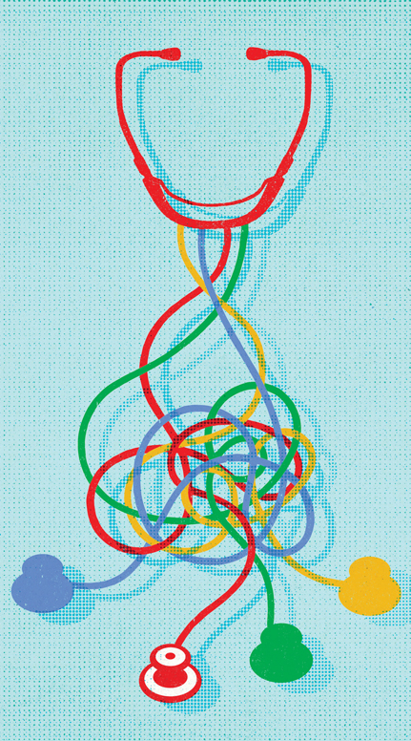
Four Principles
Beneficence: promote the well-being of individuals (and society).
Non-Maleficence: refrain from harming (or minimize harm to) individuals.
Autonomy: Respect the capacity of rational individuals to make choices in accordance with the pursuit of their own goals.
Justice: act fairly, distribute benefits and burdens fairly.

Slide 8

Principlism: General Structure
1) There are four ethical principles: Beneficence, Non-Maleficence, Autonomy, and Justice.
2) Each of the four principles is fundamental (i.e., not reducible to anything simpler or more general).
3) Each of the four principles is distinct from the others.
4) No one of the four principles enjoys a universal priority over the others.

Slide 9
Specification
The four principles provide a “suitable starting point for reflection on moral problems in biomedical ethics” (Beauchamp & Childress 2019, 13).
They “must be specified in order to achieve more concrete guidance” (17).
E.g., specifying the principle of autonomy for capacitated patients vs. incapacitated patients.

Slide 10

Balancing
The four principles sometimes conflict.
In such cases, we need to make a reasoned judgment about which considerations take priority.
Identifying where the balance of reasons lies requires ethical reflection, reasoning, and experience.

Slide 11
A Case
Capacitated patient requests treatment that’s very unlikely to provide any benefit and requires scarce resources.
Specifying the principle of autonomy: a combination of “negative” and “positive” rights.
The right to refuse treatments is very broad (perhaps unlimited), but the right to be provided with requested treatments must be balanced against other considerations:
(i) It’s not in the patient’s best interest.
(ii) The physician has their own autonomy right (that can be exercised to preserve professional integrity).
(iii) The scarce resources could be more effectively allocated elsewhere.

Slide 12
Two Important Features
It’s not simply a list of abstract principles; the theory can provide practical guidance about particular cases.
There will be difficult cases in which Principlism doesn’t yield a clear answer.
With respect to (B), Principlism is no worse off than any other ethical theory that acknowledges the possibility of conflicting types of considerations.
Ethics is complicated, and human reasoning is limited.

Slide 13
Inadequate Competitors
Kantianism maintains that consequences are irrelevant to the rightness or wrongness of an action.
But we must take into account the effective allocation of scarce resources.
Consequentialist theories (e.g., Utilitarianism) maintain that consequences are the only relevant factor for rightness and wrongness.
But it’s impermissible to pursue an individual’s best health outcome by disregarding their autonomy.

Slide 14
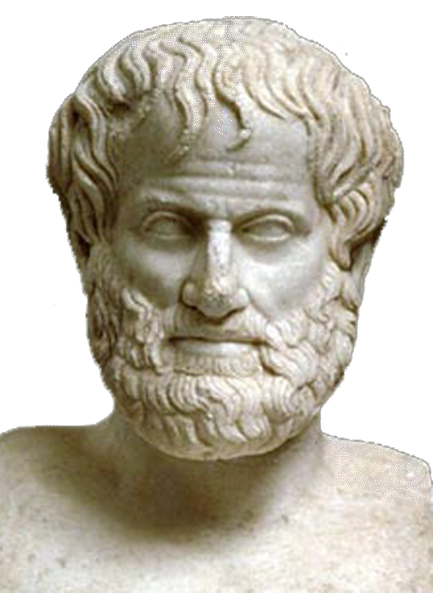
Why Principlism Succeeds
Principlism succeeds as a theory of medical ethics because:
(i) it explains what makes actions or wrong,
(ii) it provides guidance for particular cases, and
(iii) it’s appropriately modest in its guidance, given its subject matter.
Aristotle: “it is the mark of an educated man to look for precision in each class of things just so far as the nature of the subject admits.”

