Slide 1
Principlism: Not Enough
Matthew S. Smith, MD, MS, HEC-C
Notes:
Thank you to the West Virginia Network of Ethics Committees for hosting this debate and for Dr. Miller agreeing to engage with me on this debate.

Slide 2
Principles vs Principlism
Principles
  Autonomy
  Beneficence
  Nonmaleficence
  Justice
Principlism
  Equally weighted Principles
  Only Four Fundamental Prinicples
Notes:
Dr. Miller did a wonderful job explaining what all the principles that make up principlism and the general framework of Prinicplism.

Slide 3
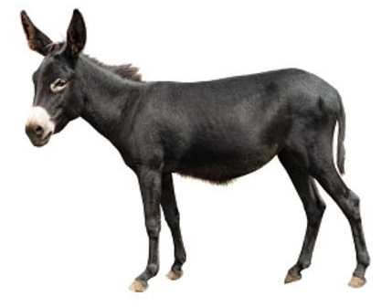
Buridan’s Donkey of Ethics
Autonomy
Beneficence
Nonmaleficence
Justice
https://www.mmweekly.com/p/mental-models-issue-56-buridans-donkey-22-12-25

Slide 4
Change the Weight Change the Theory
⬆️ Autonomy = Libertarianism
⬆️ Beneficence = Paternalism
⬆️ Justice = Rawlsianism
⬆️ Nonmaleficence = Virtue Ethics

Slide 5

Principles Are Tools, But Not Enough

Slide 6
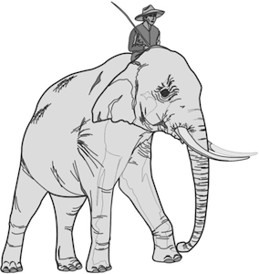
How Ethics Is Done
Forward Looking (Consequences) vs Backwards Looking (Principles)
From Neuroscience and Experience
Most people like to think they are logical
Most people are wrong
We usually Intuit what we want and then Justify the Choice with Theories/ Principles

Slide 7
Thank You
Principles = Yay!!!!
Principlism = Boo!!!

